Slide 1
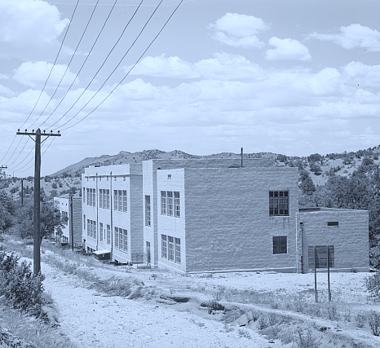
FY26 Funding Award Proposal XYZ Independent School District
ABCDEF Combined School
Presented to:
New Mexico Public School Capital Outlay Council
Presented by:
XYZPDQ​, Superintendent
Email Address: XYZPDQ@XYZ.edu
Date:
Thursday, May 7, 2026

Slide 2
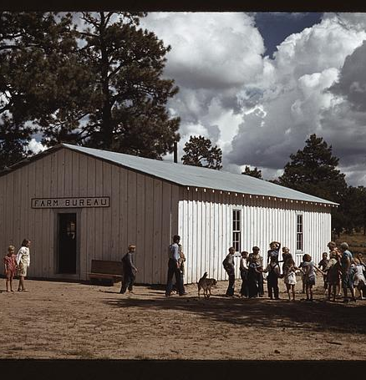
ABCDEF Combined School (wNMCI Rank: XX)
Total Project Cost: $XX,XXX,XXX (State + District)
Total Funding Request: $XX,XXX,XXX (State portion)
Project Purpose: Address critical building system failures and resulting educational adequacy deficiencies by substantially upgrading or replacing major building components at ABCDEF Combined School.
Project Need: The facility has persistent HVAC failures, roof leaks, and electrical capacity limitations that directly disrupt instruction, while also lacking sufficient and appropriately configured instructional space to meet current educational standards.
Key Deficiencies:
Frequent HVAC breakdowns causing unsafe and inconsistent classroom environments.
Roof leaks resulting in recurring damage and instructional disruption.
Electrical systems that cannot support modern instructional technology or safety demands.
Insufficient and poorly configured instructional space leading to overcrowding and non-classroom-based instruction.
Eligibility: School is ranked within the top 100 of wNMCI and is eligible for FY26 Standards-Based funding.

Slide 3
Project Location
Paste a map of your school district with the location(s) of your project(s) specified.
Note that PSFA is able to create a map for you if you need one.

Slide 4
Existing Conditions (Building Systems)
HVAC systems are failing, resulting in frequent breakdowns and inconsistent heating and cooling across classrooms and common areas
Roof systems have active and recurring leaks that damage interior finishes and disrupt instruction
Electrical systems are undersized and do not reliably support classroom technology, safety systems, or normal building operations
Building systems are beyond expected service life, requiring repeated repairs that do not resolve underlying failures
System failures directly contribute to interrupted instruction and reduced instructional time

Slide 5
Existing Conditions (Educational Adequacy)
Instructional spaces are insufficient in size and do not meet current programmatic needs.
Current school design requires use of non-classroom spaces for instruction and student services.
Room layouts and building configuration limit flexible, modern instructional delivery.
The facility does not adequately support specialized instructional programs or interventions.
Space constraints reduce the district’s ability to deliver equitable learning environments.

Slide 6
Existing Conditions (Impact on Learning and Operations)
Frequent system failures result in lost instructional time and disrupted classroom activities
Unreliable building conditions reduce staff ability to maintain consistent instruction
Environmental conditions (temperature, leaks, and equipment limitations) negatively affect student learning conditions
Ongoing maintenance demands divert resources away from educational priorities
The overall facility condition creates instability in daily school operations

Slide 7
Relationship to Facilities Master Plan (FMP)
The District Facilities Master Plan (FMP) identifies ABCDEF Combined School as a high-priority project.
The FMP identifies significant building system failures and space deficiencies at this facility.
This project aligns with the FMP recommendation for major renovation or replacement-level investment at the school.
The proposed scope directly addresses prioritized deficiencies identified in the district’s long-range capital planning process.
This project advances the district’s strategy to modernize or replace aging facilities that no longer meet educational adequacy standards.

Slide 8
Enrollment
The district evaluates ABCDEF Combined School capacity needs based on current and projected enrollment levels.
Enrollment patterns at ABCDEF Combined School and nearby schools support facility right-sizing decisions.
Enrollment at ABCDEF Combined School shows a sustained decline over the past 10 years, from XXX students in 2016 to XX students today.
Five-year projections show continued enrollment decline or stabilization at approximately XX students.
Enrollment decline creates overall underutilized capacity, while existing instructional spaces remain insufficient or poorly configured to support current educational programs.

Slide 9
Award History
Awarded funding in 2018 for HVAC system replacement. Project status: completed and closed out.
Awarded funding in 2023 for drainage remediation. Project status: currently in closeout.
Awarded FY25 funding for three electric school buses and associated charging infrastructure. Project status: implementation underway.

Slide 10
District Financial Summary – Part 1
Total Project Cost (TPC): $80,000,000
State Share (40%): $32,000,000
Local Share (60%): $48,000,000
Local Match Status: Full match provided (no reduction requested)
Local Funding Sources:
Bond proceeds: $40,000,000
Mill levy: $6,000,000
Cash on hand: $2,000,000
Project funding fully supported through identified local and state sources

Slide 11
District Financial Summary – Part 2
Local match requirement is fully met without a reduction request
Available funding sources support full delivery of planning, design, and construction phases
Total Project Cost (TPC) = $80,000,000
TPC = Planning ($250,000) + Design ($7,750,000) + Construction ($72,000,000)
Local Funding (LF) = $48 million
LF = Bond ($40,000,000) + Mill Levy ($6,000,000) + Cash on Hand ($2,000,000) = $48,000,000
Requested State funding = $32,000,000

Slide 12
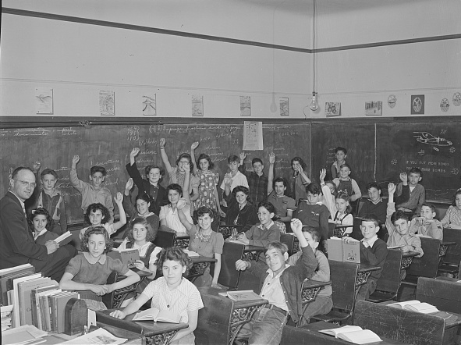
Questions?
Thank you!
For more information, please contact:
<Name>
<Title>
<Email address>
<phone number>

