Slide 1
PSCOC Capital Funding & New Programs
New Mexico Public School Facilities Authority
Workshop 2026

Slide 2
Public School Capital Outlay Council

Slide 3
PSCOOTF, PSCOC & PSFA Organization
Zuni Lawsuit
Public School Capital Outlay Oversight Task Force (PSCOOTF)
The Public-School Capital Outlay Oversight Task Force (PSCOOTF) oversees the work of the Public-School Capital Outlay Council (PSCOC) and the Public-School Facilities Authority (PSFA) as they carry out the state’s public school capital outlay program, and other programs, pursuant to the Public-School Capital Outlay Act (PSCOA).
Public School Capital Outlay Council (PSCOC)
Manages the allocation of the Public-School Capital Outlay Act Fund (PSCOF) to public school facilities.
Awards Subcommittee
Administration, Maintenance & Standards (AMS)
The subcommittee ensures the awards process is conducted fairly and efficiently, focuses on specific aspects of the awards process including: Evaluating recommendations for awards and selecting recipients based on criteria; Formulating policies regarding language & facilitating awards processes.
The subcommittee reviews and provides guidance on policies and standards, strategic planning and maintenance processes.
Public School Facilities Authority (PSFA)
Staff to the PSCOC. Distributes state funding, partners with districts to manage PSCOC awarded projects, collect and organize public school facility data.

Slide 4
PSCOC Members
Joe Guillen – PSCOC Chair
New Mexico School Boards Association
Shawna Casebier – Legislative Council Services
John Sena – Legislative Education Study Committee
Ashley Leach – Administration, Maintenance & Standards Chair
Department of Finance & Administration
Charles Sallee – Awards Chair
Legislative Finance Committee
Stewart Ingham – Public Education Commission
Elizabeth Groginsky
Governor’s Office
Mariana Padilla
Public Education Department
Clay Bailey
Construction Industries Division

Slide 5
Public School Facilities Authority (PSFA)

Slide 6
PSFA Core Functions
Project Management
Facility Information Management
Staff to PSCOC
Funding Administration
Role defined by NM Administrative Code.
Provide research and analysis to decision-makers on PSCOC.
Distribution of state funding to all school districts, in compliance with statute.
Partner with school districts on planning, design, and construction projects (including technology infrastructure) to provide project management support and technical expertise.
Assess, gather, and organize facility information for all schools in NM.
Calculate the wNMCI score to produce the statewide ranking of public schools.
Assist districts in monitoring and improving maintenance and energy efficiency.
Services provided to school districts

Slide 7
PSFA Teams
Reviews, analyzes and approves district five-year Facilities Master Plans
Analyzes enrollment, demographics, feasibility studies, educational program, school capacity and utilization, etc.
PLANNING
Assesses schools, identifies facility systems and educational adequacy deficiencies
Calculates wNMCI scores
Prioritizes schools for PSCOC funding, via the wNMCI Ranking
FACILITIES
Accepts and reviews district applications
Works with districts to determine project scope and calculate potential award amounts
Recommendations award considerations to the PSCOC.
PROGRAMS
FIELD
Collaborates with districts to co-manage PSCOC funded projects, through the planning, design, and construction phases.
FINANCE & PROCUREMENT
Disburses funding for PSCOC funded awards / projects.
Assists districts with procurement of contracts, ensuring procurement code is followed
MAINTENANCE
Assists districts with Preventive Maintenance Planning and FIMS use
Monitors and helps improve district maintenance performance and energy efficiency

Slide 8
State of Our Schools
62,706,266 sq. ft. of public-school assets
89 Public School Districts | 3 Constitutional Schools | 106 Charter Schools +/- | 900+ Buildings/Assets (1900 t0 2025)
Replacement Value: $19.5 billion+
337,847 students and 21,700 teachers
Elementary, Middle, High Schools, Combo Schools, Pre-K, Charters
Public School Capital Outlay Impact
24 Years - $ Billions
Facility Information Management System (FIMS): $6M+
Maintaining our investments $
Roadways, utilities, playgrounds, restrooms, lighting fire protection, HVAC, security windows, doors, roof systems

Slide 9
Current Funding Programs FY26
www.nmpsfa.org
Key Dates: July 1, 2025 – Applications released | September 30, 2025 – Applications close
April-May 2026 PSCOC – Standards, Systems and Pre-K Awards made
STANDARDS-Based Capital Outlay
New, replacement, renovation or addition of school facilities
340 Projects, 72 districts, $2.8B State funding.
SYSTEMS-Based Capital Outlay
Replacement or upgrade of select building systems
295 Projects, 67 districts, $201M State funding.
PRE-KINDERGARDEN Capital Outlay
New, replacement, renovation or addition of Pre-kindergarten
34 Projects, 20 districts, $29M State funding.
TEACHER HOUSING
Pilot – on hold
Housing for schools in rural / tribal areas with no available housing for teachers to rent or purchase. Program is currently on hold.
$10M+ in the pilot program.
LEASE ASSISTANCE
Lease Reimbursement for charter and district schools.
FACILITY MASTER PLAN ASSISTANCE
FMP funding assistance – district hires planning vendor
292 Master Plan Awards, $8.4M in State funding.
Notes:
PSFA has evolved over time to include Standards (340 Projects/72 Districts $2.8 B) , Systems (295 Projects/67 Districts $201M State Funding, Pre-K, Techer Housing, Security, Emergency, Appropriations, Lease Assistance, FMP, CIMS, FIMS

Slide 10
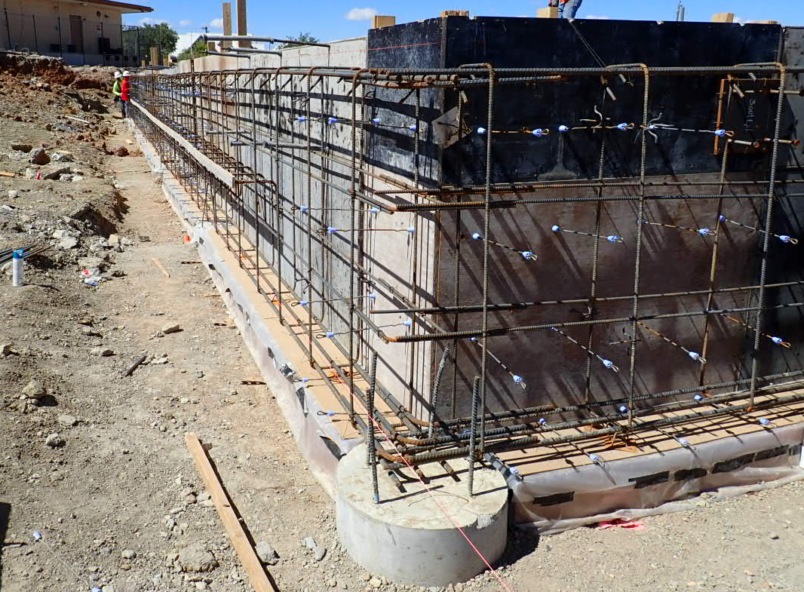
Current PSCOC Active Projects
ACTIVE PROJECTS: 153
66 Standards Based Projects
73 Systems Based Projects
10 Pre-Kindergarten Projects
4 Teacher Housing Projects (Standards)
5 Teacher Housing Pilot Projects
38 Facility Master Plans
5 Measurement and Verification Pilot Projects
Pilot Program Phase II moving forward
Notes:
Capital Outlay funding has exceeded $3.1 Billion in funding: Standards, Systems, Pre-K, TH, FMP’s CIMS, FIMS legislative appropriations and more.

Slide 11
Facility Assessment Database & wNMCI Ranking

Slide 12
Facilities Assessment Database (FAD) Weighted New Mexico Condition Index
A tool used to prioritize public school facilities for funding through the Public-School Capital Outlay Council (PSCOC).
Building repair cost, System lifecycle analysis with the New Mexico Adequacy Standards.
The Weighted New Mexico Condition Index (wNMCI) is the metric used to compare and prioritize schools for capital outlay funding. It is calculated based on:
The age and condition of the overall facility and individual building systems.
Building systems that are beyond expected life span have a higher weight factor.
Building systems with condition issues receive higher weight factors, depending on severity.
Educational adequacy via New Mexico Adequacy Standards.
Key priorities: life, health, safety & insufficient educational space.
FAD serves as the central hub for data collection and the calculation of each unique schools’ wNMCI.

Slide 13
wNMCI Ranking
PSFA produces the wNMCI Final Ranking on an annual basis.
The wNMCI ranking enables the comparison of all K-12 public schools in the state to determine greatest need for funding the correction of school deficiencies.

Slide 14
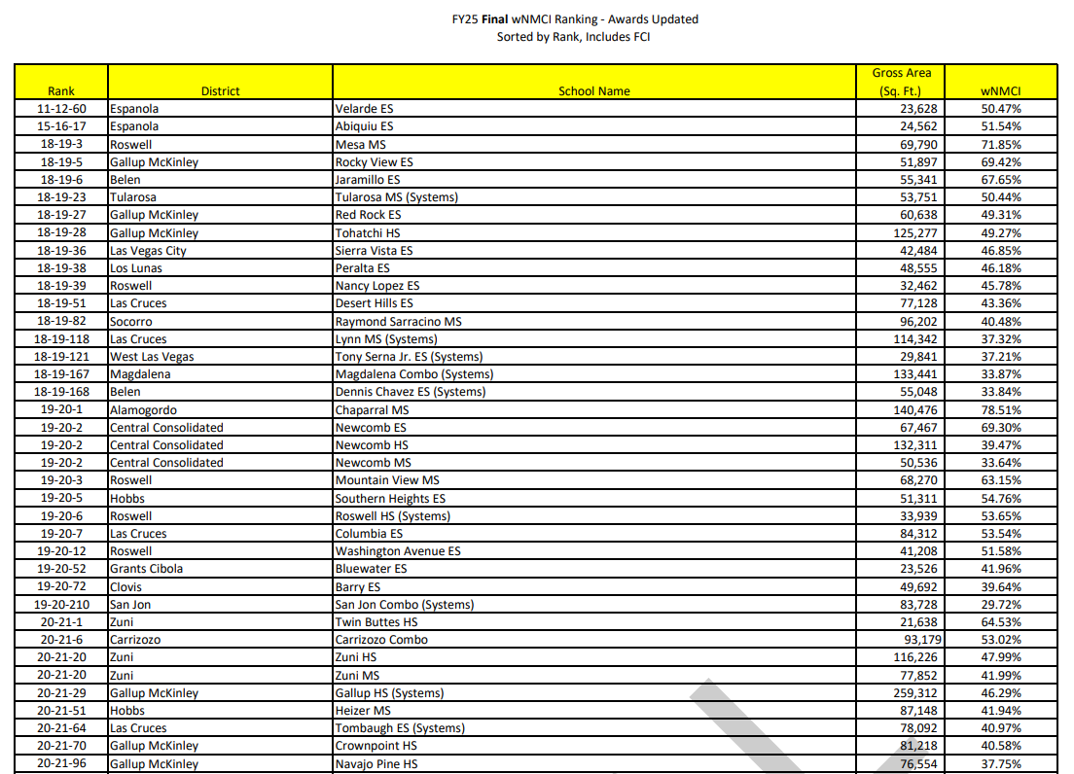
wNMCI Ranking – How to Read
PREVIOUSLY FUNDED PROJECTS
The first section of the wNMCI Ranking lists all current existing PSCOC funded projects.
These schools are not included in the body of the ranking, until the projects are complete.

Slide 15
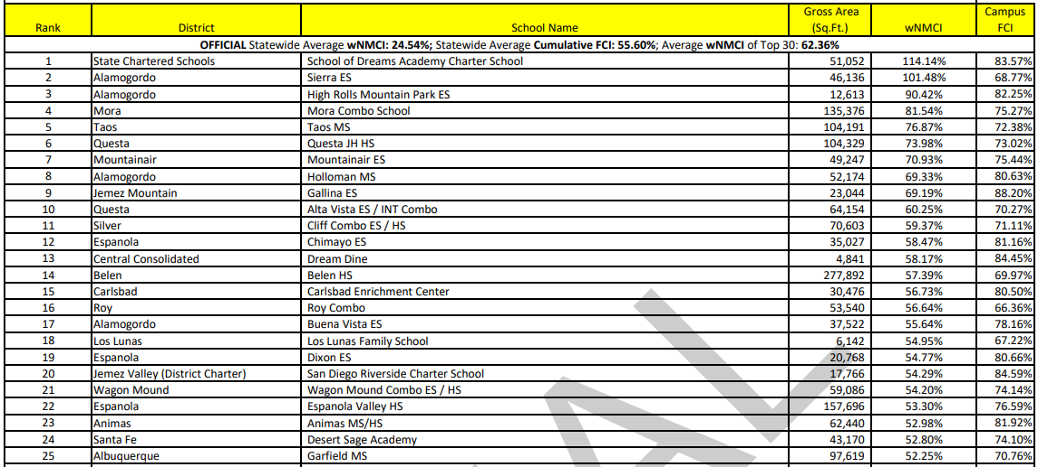
wNMCI Ranking – How to Read
Gross Square Footage of Campus
Weighted New Mexico Condition Index Score
Ranking is sorted by this score, correlates to the ranked positions
Facility Condition Index Score

Slide 16
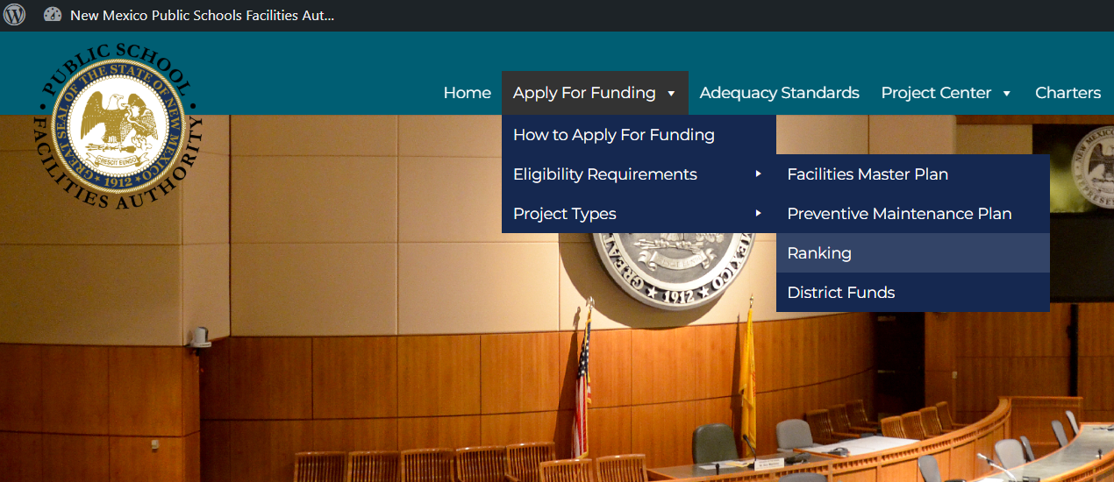
wNMCI Ranking – Where to Find
The FY26 final wNMCI Ranking is posted on the PSFA website:
Home Page – www.psfa.org
> Apply For Funding
> Eligibility Requirements
> Ranking: The FY26 final wNMCI Ranking is sorted in 3 ways for ease of use:
by Rank, FCI, or District/School

Slide 17
Facility Master Plans (FMP)

Slide 18
FMP
Facility Master Plan
Section 22-24-5.B (11) NMSA 1978 states a district seeking public school capital outlay funding must submit a 5-year facilities master plan.
FMP helps to prioritize.
Demographic shifts
Space Needs
Too much space that costs money to maintain and operate;
Too little space and need additions or new schools; and/or
Facilities that are old and unable to support changing needs of modern education.
Magnified when you have many school buildings and campuses to address
Improving, upgrading, maintaining a school building or campus can be intimidating and overwhelming – where to start?
Facility Master Plan
A Facilities Master Plan is a living document that districts should review and update annually.

Slide 19
FMP
Facility Master Plan
An organizational management and budgeting tool that identifies priorities, critical facility capital and system needs
All information and data on school facilities in one place
Building systems
Building condition
Capacity/Utilization
Floor and site plans
Demographic and socioeconomic profile including trends and projections.
Data about facility use – helps to organize existing or new space to accommodate program changes and needs.
Planning demonstrates a strategy behind facility improvement decision making in order to maximize taxpayer dollars.
FMP Identifies priorities and options for each school and district facility and projects needed to meet priorities
FMP assigns financial resources to each project
GO Bonds, SB-9/HB-33, Public School Capital Outlay Award
Establishes time frames for project implementation.

Slide 20
PSCOC Funding Programs

Slide 21
PSCOC Funding Programs
PROGRAM |  |  | ELIGIBILITY
Standards | School / building replacement, renovation, or additions |  | Top 100 of current ranking
Systems | Select building system replacement or upgrade | Exterior envelope Mechanical Electrical Plumbing Special systems (fire detection/suppression, communications) Site drainage Utilities | Top 300 of current ranking, or Category 1 designation of a specific system in FAD
 | Demolition |  | Abandoned facility
Pre-Kindergarten | Pre-Kindergarten facilities and classrooms – renovation or additions |  | Any school facility, must have a Pre-K program
Teacher Housing On hold | Teacher housing units in rural / tribal areas with no available housing |  | No available housing in rural community
Lease Assistance | Lease reimbursement for charter schools and district schools |  | School leases facility
Facilities Master Plan Assistance | FMP funding assistance |  | Five-year master plan has expired, or is expiring soon

Slide 22
PSCOC Funding - Requirements
Weighted NM Condition Index: To qualify for an award a district must be ranked in the current year wNMCI Ranking within the Top 100 for Standards and top 300 for Systems (NMSA Article 24, Chapter 22:-24-5 (B) (9)).
District Local Match percentage is available at the time of award.
Local Match Reduction Opportunities
Current and approved Facility Master Plan (FMP): Section 22-24-5.B (11) NMSA 1978 states a district seeking public school capital outlay funding must submit a 5-year facilities master plan (FMP).
Updated on a five-year cycle
FMP prioritizes application request as a need / potential project
Current and approved Preventive Maintenance (PM) Plan: NM State Statute (22-24-5.3.NMSA 1978, Preventive Maintenance Plans; Guidelines; Approval and 6.27.3.11 NMAC)
Must be updated annually
District use of Facility Information Maintenance System (FIMS): NM State Statute (NMSA 22-24-5.5 NMSA 1978).
Since 2005 the Public School Capital Outlay Council (PSCOC) has required districts to use the Facility Information Management System (FIMS) as a prerequisite for awarding capital outlay funding.
Facility Maintenance Assessment Report (FMAR): Recommended minimal score of 70%, satisfactory
Notes:
Facility Master Plan: An organizational management and budgeting tool that identifies priorities, critical facility capital and system needs.
Preventive Maintenance Plan: An organizational management tool that identifies how a district plans to maintain public school investments.

Slide 23
State / Local Match
Capital funding for public school facilities is a shared responsibility between the State and school districts.
Each school district is assigned a Local Match percentage.
District is responsible for funding this percentage of the total project cost for a PSCOC funded project / award.
Districts may apply for a Local Match Reduction (waiver) if it meets eligibility and proves financial need.
2023 Senate Bill 131
Reduced Local Matches by
1/3 for districts with more than 200 MEM
½ for districts with less than 200 MEM or fewer
½ for all Pre-Kindergarten Projects
Public school capital outlay projects; application; grant assistance, § 22-24-5.B.(5) NMSA1978
FY26 State/Local Match percentages are posted on the PSFA Capital Funding webpage: www.psfa.org

Slide 24
How to Apply
District submits a Pre-Application (letter of intent) to PSFA.
Dear Public School Capital Outlay Council,
Introduction:
Specify the PSCOC capital funding program (Standards-based, Systems-based, Pre-K, or Pilot Teacher Housing).
Specify the school the district is applying for.
Eligibility :
Verify that the applicant school is eligible for PSCOC capital funding, per the eligibility requirements: school’s ranking, wNMCI score.
Application Request and Project Scope:
Describe the requested project.
Explain the reasoning and need for the requested project.
Provide a description of the project scope.
Estimated Costs:
Provide estimated costs for the potential project.
Funding:
Confirm if the district does or does not have sufficient available funding to support to the local match.
Indicate if the district will request and require a local match reduction.
Signed, School District

Slide 25
Application to Award Process
PRE-APPLICATION
District submits pre-application (letter of intent) to PSFA
PSFA REVIEWS & PROCESSES APPLICATION
PSFA staff collaborates to review / analyze district applications
Confirm eligibility – ranking, FAD
FMP, maintenance, finance requirements
Evaluate project need / potential scope / estimated costs
Conduct site visits (complicated / large projects)
FINAL APPLICATION
PSFA staff (Programs Manager) assist districts to complete the Final Application
DISTRICT PRESENTATION (in most cases)
District presents final request to PSCOC, explains need for potential project
PSFA RECOMMENDATION
PSFA presents final recommendation to the PSCOC
PSCOC AWARDS
Determines project prioritization, if needed (dependent on funding availability)
PSCOC approves awards and award amount for each application/request
PSCOC FUNDED PROJECT
PSFA processes award (award letter & MOU)
PSFA and district co-manage project throughout all processes (planning, design, construction)
PROJECT

Slide 26
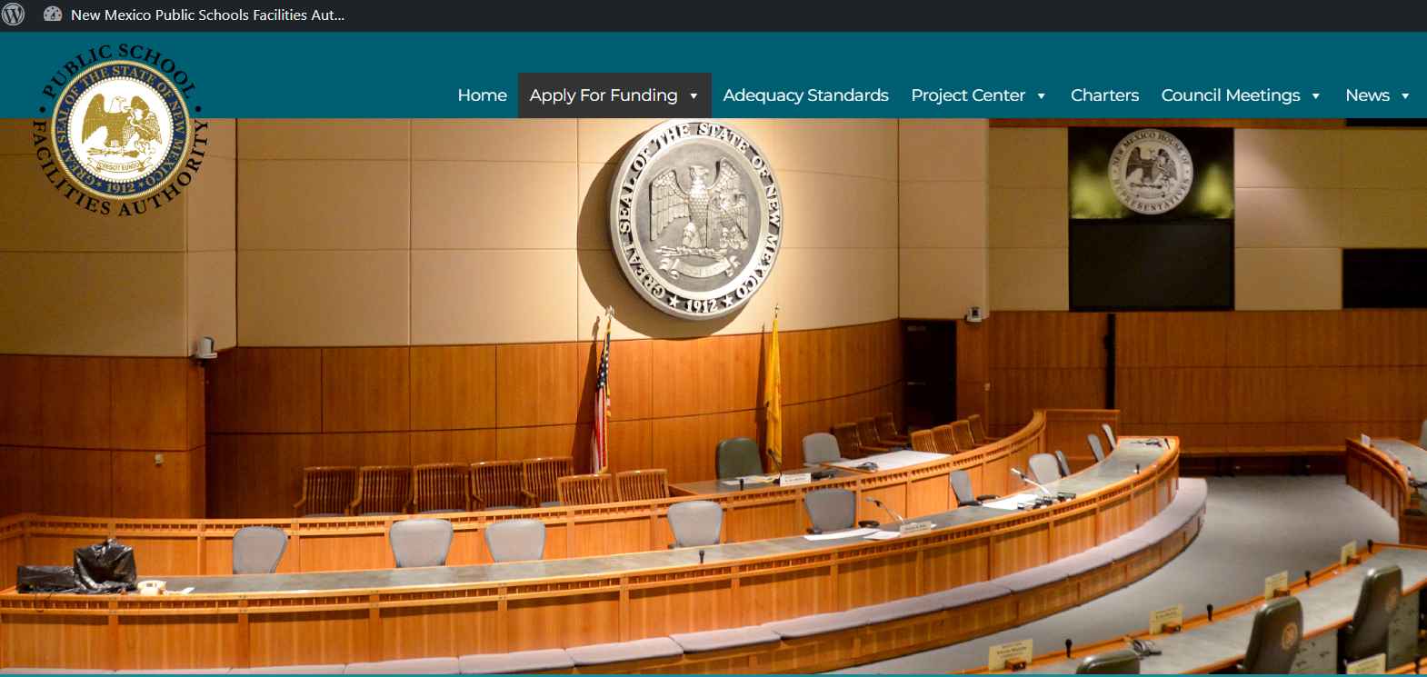
More Information
www.psfa.org

Slide 27
PSFA/PSCOC Funding Overview Matthew Schimmel, Chief Financial Officer

Slide 28
PSFA/PSCOC Funding Overview
Public School Capital Outlay Act (PSCOA) - Chapter 22, Article 24 (§ 22-24 NMSA1978)
The PSCOA is the New Mexico law that provides a statewide system for funding, evaluating, and improving public school facilities to ensure they are safe, adequate, and equitable.
Public school capital outlay projects; application; grant assistance. Chapter 22, Article 24, Section 5 (§ 22-24-5. NMSA1978)
Establishes the rules for how New Mexico public school districts apply for, qualify for, and receive capital outlay grant assistance, including how projects are prioritized and funded.
Public School Capital Outlay Act (PSCOA) – Chapter 22, Article 24 (22-24 NMSA 1978) NMAC
Public school capital outlay projects; application; grant assistance. Chapter 22, Article 24, Section 5 (§ 22-24-5. NMSA1978)
Where does the funding that supports the PSCOA come from?

Slide 29
Supplemental Severance Tax Bonds (SSTBs)
Funded through taxes generated from oil and gas extraction in New Mexico
Projected capacity levels are established by the State Board of Finance (BOF)
Authority to issue bonds twice annually (June and December)
Bond sales are prioritized and executed based on demonstrated need
Bond issuance is coordinated with BOF staff and approved by the PSCOC and BOF
Projects may be recertified or decertified as conditions change
Currently managing 34 active bonds, with the oldest dating back to 2013

Slide 30
PSCOC Funding Uses
PSCOC Awards
Standards-based
Systems-based
Pre-Kindergarten
Teacher Housing
Pilot currently on-hold
Demolition
5-Year Facility Master Plans
Lease Payment Assistance
Life, Health, Safety Emergencies
Measurement & Verification
Broadband
Formerly under PSFA; now managed by the Department of Information Technology
State Fire Marshal & Construction Industries Division Inspections
Legislative Distributions & Appropriations
SB-212, HB-505, HB-450
SB-9, HB-119
PSFA Operating Budget

Slide 31
Sources of Funding for Districts
PSCOC Awards
requires state/local match
General Obligation Bond Elections
Mill Levies
SB‑9
HB‑33
Operational Funding
PED Secretary approval
Legislative Appropriations
not compatible with PSCOC awards
Federal Grants

Slide 32
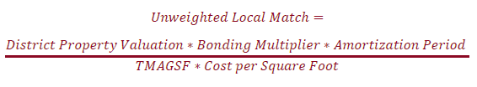
State | Local Match
Public school capital outlay projects; application; grant assistance, § 22-24-5.B.(5) NMSA1978
TMAGSF: Total Maximum Allowable Gross Square Footage
----------------------------------------------------
Full Phase 2 formula integration in FY24
Previous studies from the University of New Mexico’s Bureau of Business and Economic Research (BBER)
Local match reduced by Senate Bill 131 (2023):
one‑third for all districts
one‑half for micro‑districts (200 MEM or fewer)
Currently under review by the Legislative Finance Committee & Legislative Education Study Committee

Slide 33
Local Match Reductions
§ 22-24-5.B.(9)(a-b) NMSA1978:
“the council may adjust the amount of a school district's local share otherwise required if it determines that the school district has made a good-faith effort to use all of its local resources. Before making any adjustment to the local share, the council shall consider whether:”
(a) Insufficient bond capacity over the next four years & residential mill rate of at least 10
(b) MEM below 1,500 students & residential mill rate of at least 7
Districts must complete a PSFA‑provided statement of financial position
PSFA reviews and validates the submitted information
PSCOC considers and approves eligible requests
Requests have increased due to rising construction costs

Slide 34
Community Benefit Fund Electric Bus Grants Claude Morelli, Planning and Design Manager

Slide 35
Community Benefit Fund (CBF) Electric Bus Grant Program
Established (2025, SB48)
Statewide initiative to advance renewable energy
PSFA manages a portion of the program
Funding
$60 million appropriated (HB2)
Available over a three-year period (FY2026, FY2027, FY2028)
Scope of PSFA Involvement
EV charging infrastructure for school districts
Provide grants to support transition from diesel to electric school buses

Slide 36
CBF – Electric Bus Grants Timeline of Events Round 1
Date | Event
July 15, 2025 | Round 1 applications opened
August 31, 2025 | Round 1 applications closed; applications received through PED, PSFA CFO, and the designated funding email
September 1, 2025 | Round 2 applications opened (paused due to staffing issues, need for improvements, and delays in Round 1 distribution)
September 15, 2025 | Target date for Round 1 distributions (not met)
October 24 –October 28, 2025 | Actual Round 1 award letters issued
Round 2 Application Cycle
September 1, 2025 | Opened but paused

Slide 37
CBF – Electric Bus Grants Summary of Round 1 Applicants & Distributions
District | Awarded Amount | Description
Albuquerque Public Schools | $ 4,500,000 | Ten electric school buses, ten charging stations, and electrical system upgrades. Total quoted cost: $4,164,045. Additional funds included for unforeseen costs.
Kinteel Residential Campus (Aztec) | $ 1,000,000 | Two electric school buses, two charging stations, and electrical upgrades. Total quoted cost: $968,750.16. Additional funds included for unforeseen costs.
Las Cruces Public Schools | $ 750,000 | Five charging stations and installation costs. Total quoted cost: $672,995.39. Additional funds included for unforeseen costs.
Rio Rancho Public Schools | $ 4,000,000 | Six electric school buses, five charging stations, and electrical upgrades. Total quoted cost: $3,631,771.26. Additional funds included for unforeseen costs.
Total Distribution | $10,250,000

Slide 38
CBF Electric Bus Grants Round 1 Challenges
Program Launched Quickly
Legislation passed early 2025
PSFA lost key staff in Spring 2025
Simple Design – Big Demand
First-come, first-served application
Minimal expected PSFA involvement
Unexpected Complexity
Applications far exceeded expectations
Needed oversight, coordination and technical support
Involved districts, vendors, nonprofits, and other agencies.

Slide 39
CBF Electric Bus Grants Round 2 Preparation Stakeholder Engagement
With new 2026 staffing—PSFA is better positioned to strengthen program administration.
Planned improvements include:
Ongoing, more structured engagement with districts and applicants
Expanded vendor outreach, fact finding, and technical research
Collaboration with nonprofits supporting electrification
Increased coordination with legislators involved in the initiative
A redesigned application and review process for future funding rounds
These steps will support more equitable, transparent, and goal‑aligned Community Benefit Fund distributions.

Slide 40
Maintenance in New Mexico Public Schools Preventive Maintenance Planning Facility Information Management System (FIMS) Facility Maintenance Assessment Report (FMAR) Exemplary Maintenance

Slide 41
Preventive Maintenance Plan
A statute A statute driven (annually updated) written plan on how districts manage districts Maintenance & Operations. NM State Statute (22-24-5.3.NMSA 1978, Preventive Maintenance Plans; Guidelines; Approval and 6.27.3.11 NMAC): - All public and charter school districts must have a current and PSCOC approved preventive maintenance plan.
The PM Plan includes:
Maintenance Mission Statement & Goals
Organization & Staffing infrastructure
Priorities, Procedures & Training
Inspection Schedules & Tasks
Reduction of Life, Health & Safety Issues
Planned Capital Maintenance & System Renewal Projects.
A Best practice template is available supporting NM Districts success in PM Planning efforts.
22-24-5.3.NMSA 1978, Preventive Maintenance Plans; Guidelines; Approval and 6.27.3.11 NMAC
PM Plan Benefits:
Improved Building System Reliability
System Life Cycles are met or extended
Quality Educational Environments
Reduced and Streamlined Costs
Contact PSFA Maintenance Division for more information

Slide 42
Facility Information Management System (FIMS)
A Computerized Maintenance Management System. NM State Statute (NMSA 22-24-5.5 NMSA 1978): - Since 2005 the Public School Capital Outlay Council (PSCOC) has required districts to use the Facility Information Management System (FIMS) as a prerequisite for awarding capital outlay funding. The PSCOC has subsidized FIMS licensing costs for all districts—districts have access to FIMS at no cost.
Maintenance Direct (MD) - documents and manages the entire maintenance work order process from request to completion, to include expenditures, and provides for data analysis and reports. Asset Essentials
Preventive Maintenance Direct (PMD) - assists in creating, scheduling, assigning, and managing recurring preventive maintenance (PM) tasks for all district facility equipment. Asset Essentials
Utility Direct (UD) - tracks and analyzes utility types, consumption and costs to identify savings opportunities leading to the development of energy management programs. Sunset in December 2025
Unlimited training and technical support is available
22-24-5.5. Preventive maintenance plans; participation in Facility Information Management System
Maintenance Costs $.
Preventive vs. Reactive is a 3 to 1 ratio.
FIMS brings significant benefits to facility management:
Reduces reactive work orders
Plans, tracks preventive maintenance processes extending system life cycles
Reduces unnecessary expenditures through better planning
Generates actionable facility data for decisions
Contact PSFA Maintenance Division for more information

Slide 43
Facility Maintenance Assessment Report (FMAR)
The FMAR is a process tool used to evaluate NM school facilities conditions / appearance and determine and verify the implementation level of an effective maintenance management program. Combines the PM Plan, FIMS use and a Facility Assessment to determine how well districts are maintaining the assets within the schools environment.
During the FMAR assessments:
22 Building Categories are reviewed.
Deficiencies: life, safety, health or property damage is identified.
FMAR findings can be used to determine deferred maintenance and/or capital renewal needs. These identifiers should be considered for inclusion into the districts long range capital planning (FMP).
School Districts have access to the FMAR database to review historical and current performance for each of the district’s schools assessed. Districts are encouraged to review the data and respond to unfavorable conditions to improve performance ratings within 60 days.
Are you maintaining your capital investments?
Training available to school districts:
Facility Manager and Operational Certificate Program
Preventive Maintenance Planning
Facility Information Management System
Contact PSFA Maintenance Division for more information

Slide 44
Exemplary Maintenance
NM Administrative Code (NMAC) 6.27.3.11, Preventive Maintenance Program: Updated July 2010 to include an incentive for public schools to develop exemplary preventive maintenance programs which may provide up to a 5% reduction in local match on capital outlay award.
Eligibility Criteria:
FMAR district average performance rating better than 90.1% (Outstanding)
Current & approved PM Plan on file with PSFA (PMP)
Use of all 3 Facility Information Management System (FIMS) modules to a 2.0 performance level or greater
Ten (10) types of equipment being maintained within the FIMS preventive maintenance program
Preventive maintenance work order completion rate of 90% or greater
Transaction rate of above 100%
Meaningful Maintenance Metrics (M³) or other data driven report implemented and shared with district Superintendent and School Board.
Candidates must show 2-year historical performance
Exemplary maintenance is demonstrated by achieving and sustaining optimum performance of all building systems expected useful life anticipated to be met or exceeded through highly efficient use of resources.
NM Administrative Code (NMAC) 6.27.3.11, Preventive Maintenance Program
Are you maintaining your capital investments?

Slide 45
Energy Management

Slide 46
Measurement & Verification
Nationwide, K–12 schools spend over $8B annually on energy; 30% is wasted.
In New Mexico, $95M spent on utilities in 2024.
Since 2006, PSFA has partnered with districts through FIMS-Utility Direct.
Basic utility billing energy management
PSFA launched pilot initiatives to improve energy and water efficiency.
2014 Pilot 1
2023/2024 Pilot 4
2024 Pilot 4 Program progressed with real-time tracking and analytics platform.
Pilot Program - “Vision into Reality” > Goals
5 districts, 166 buildings
8,468,290 SF
71 Meters, 1,580 accounts
“M & V is the process of planning, measuring, collecting and analyzing data for the purpose of verifying and reporting energy savings with an individual facility resulting from the implementation of energy conservation measures(ECMs).”
Success Story
Are you maintaining your capital investments?
Notes:
NM Public Schools energy and water use is the second-highest operating expense for schools after salaries and benefits. New Mexico school districts spent $95 million on utilities in 2024. With costs rising and sustainability becoming a statewide policy, PSFA launched an initiative to help districts manage energy and water use more efficiently and effectively. Driven by IECC International Energy conservation code 2021.

Slide 47
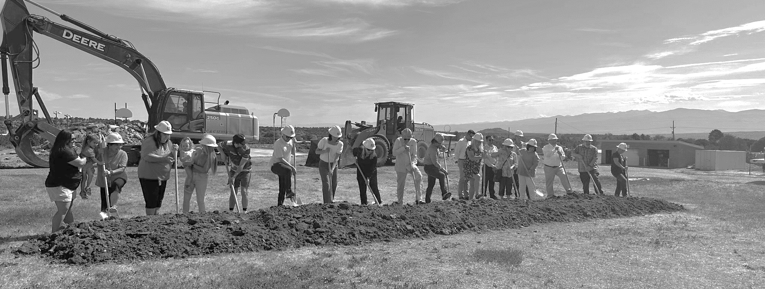
Marcos Trujillo
Executive Director
mtrujillo@nmpsfa.org
Matthew Schimmel
Chief Financial Officer
mschimmel@nmpsfa.org
Claude Morelli
Planning & Design Manager
cmorelli@nmpsfa.org
Larry Tillotson
Deputy Director of Operations & Quality Assurance
ltillotson@nmpsfa.org
www.nmpsfa.org

